Slide 1

Social Topic Distributions
Mürüvvet Hasanbaşoğlu
Hakan Akyürek
Technical University of Munich
Faculty of Informatics
Munich, 20. July 2020

Slide 2
Outline
Motivation
Data
Experiments
Results

Slide 3
Outline
Motivation
Data
Experiments
Results

Slide 4






Motivation
Agriculture
Amazon to buy Whole Foods Market in deal valued at $13.7 billion
Amazon.com jolted the grocery industry Friday when it announced plans to buy Whole Foods Market, introducing new uncertainty to a sector already struggling to keep up with growing competition. The $13.7 billion deal heightens a years-long battle between Amazon, the Internet darling, and powerhouse merchants such as Walmart, which recently beefed up its online operations with a $3.3
billion purchase of an Amazon competitor. Now Seattle-based Amazon - which for years has been testing grocery innovations in quiet corners - could lay claim to a fleet of more than 460 stores throughout the United States, Canada and Britain…..
Comments:
Guy above shows that this is not the scenario I thought it was. Still annoying though - Yeah, I definitely missed that development. I wonder if that will eventually be deemed illegal...
I enjoy shopping with Amazon. I am a Prime member and their shipping and customer service is However, I am considering not renewing next year as I have split some of my shopping over to Jet.com (Which Walmart acquired last year)....
There are I mean literally very few. But the dishes are priced. is one of the leading Organic caterers in Bangalore. With over a 100 organic dishes,....
Economy
You can find many online grocery stores like Dalbasket which is well-established and renowned for providing the different types of pulses...
Politics
Organic Food

Slide 5
Outline
Motivation
Data
Experiments
Results

Slide 6
Data
Curated Organic Dataset |  |  | # of articles | # of users
Biased |  | Facebook | 5,013 | 4,705
 |  | Food Babe | 15 | 15
 |  | Food Revolution | 78 | 60
 |  | Organic Authority | 66 | 0
 |  | Organic Consumers | 64 | 0
Unbiased | Forum | Cafe Mom | 86 | 85
 |  | Disqus | 36 | 36
 |  | Quora | 567 | 523
 |  | Reddit | 81 | 78
 |  | US Message Board | 0 | 0
 | News sites | Chicago Tribune | 2,283 | 78
 |  | Huffington Post | 880 | 0
 |  | LA Times | 1,522 | 77
 |  | NY Post | 106 | 0
 |  | NY Times | 438 | 137
 |  | USA Today | 95 | 22
 |  | Washington Post | 1,563 | 943
12,893
164,387
Tokenization: r"[a-zA-Z0-9]+|\.|\?|\!"
Lowercase
Stop word removal
Rare word removal
Tokens | Vocabulary
~19M | 88,119

Slide 7


Data
Curated Organic Dataset |  |  | # of articles | # of users
Biased |  | Facebook | 5,013 | 4,705
 |  | Food Babe | 15 | 15
 |  | Food Revolution | 78 | 60
 |  | Organic Authority | 66 | 0
 |  | Organic Consumers | 64 | 0
Unbiased | Forum | Cafe Mom | 86 | 85
 |  | Disqus | 36 | 36
 |  | Quora | 567 | 523
 |  | Reddit | 81 | 78
 |  | US Message Board | 0 | 0
 | News sites | Chicago Tribune | 2,283 | 78
 |  | Huffington Post | 880 | 0
 |  | LA Times | 1,522 | 77
 |  | NY Post | 106 | 0
 |  | NY Times | 438 | 137
 |  | USA Today | 95 | 22
 |  | Washington Post | 1,563 | 943
12,893
164,387
Tokenization: r"[a-zA-Z0-9]+|\.|\?|\!"
Lowercase
Stop word removal
Rare word removal
Tokens | Vocabulary
~19M | 88,119
Word embeddings ➜ GloVe
Sentence embeddings ➜ Universal Sentence Encoder

Slide 8
Data
Curated Organic Dataset |  |  | # of articles | # of users
Biased |  | Facebook | 5,013 | 4,705
 |  | Food Babe | 15 | 15
 |  | Food Revolution | 78 | 60
 |  | Organic Authority | 66 | 0
 |  | Organic Consumers | 64 | 0
Unbiased | Forum | Cafe Mom | 86 | 85
 |  | Disqus | 36 | 36
 |  | Quora | 567 | 523
 |  | Reddit | 81 | 78
 |  | US Message Board | 0 | 0
 | News sites | Chicago Tribune | 2,283 | 78
 |  | Huffington Post | 880 | 0
 |  | LA Times | 1,522 | 77
 |  | NY Post | 106 | 0
 |  | NY Times | 438 | 137
 |  | USA Today | 95 | 22
 |  | Washington Post | 1,563 | 943

Slide 9
Data
Curated Organic Dataset |  |  | # of articles | # of users
Biased |  | Facebook | 5,013 | 4,705
 |  | Food Babe | 15 | 15
 |  | Food Revolution | 78 | 60
 |  | Organic Authority | 66 | 0
 |  | Organic Consumers | 64 | 0
Unbiased | Forum | Cafe Mom | 86 | 85
 |  | Disqus | 36 | 36
 |  | Quora | 567 | 523
 |  | Reddit | 81 | 78
 |  | US Message Board | 0 | 0
 | News sites | Chicago Tribune | 2,283 | 78
 |  | Huffington Post | 880 | 0
 |  | LA Times | 1,522 | 77
 |  | NY Post | 106 | 0
 |  | NY Times | 438 | 137
 |  | USA Today | 95 | 22
 |  | Washington Post | 1,563 | 943
➜ 150 Articles
User datasets:
Answering Users
Random Users:
General
Biased
Unbiased
Forum
News sites
➜ 150 Articles
➜ 150 Articles

Slide 10
Outline
Motivation
Data
Experiments
Results

Slide 11
Experiments
All word embeddings
[0.27 0.41 ... -0.14]
[0.31 0.09 ... -0.04]
All sentence embeddings
[0.10 0.28 ... 0.21]
[-0.10 0.04 … -0.09]
GMM
GMM

Slide 12
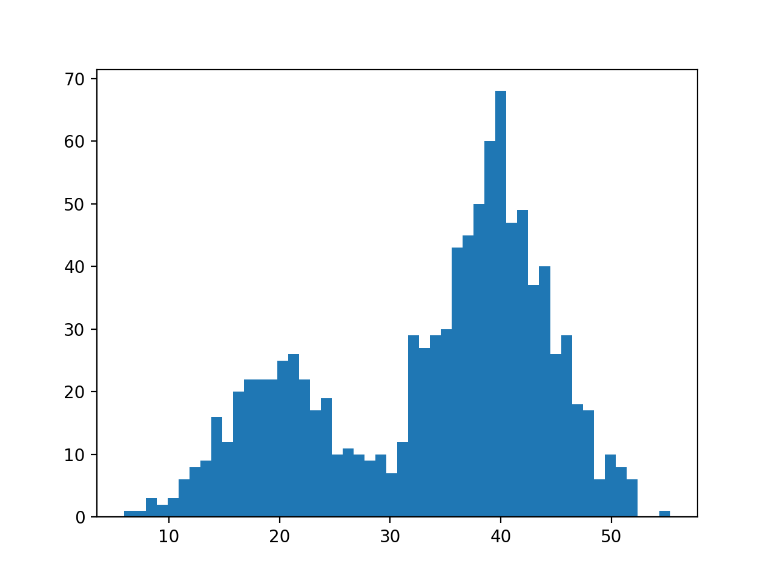
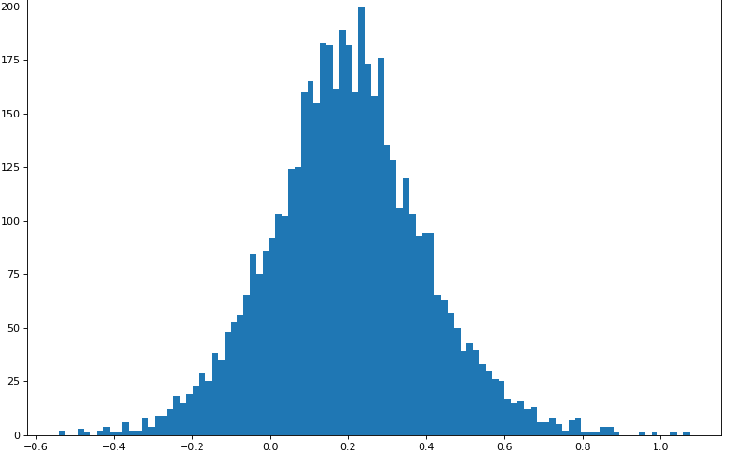
Experiments
All word embeddings
[0.27 0.41 ... -0.14]
[0.31 0.09 ... -0.04]
All sentence embeddings
[0.10 0.28 ... 0.21]
[-0.10 0.04 … -0.09]
GMM
GMM
‘organic’
𝑣 = [-0.22 0.31 ... 0.22]
⤶
‘enjoy shopping amazon ?’
[0.22 0.26 … 0.25] = 𝑣
⤷

Slide 13
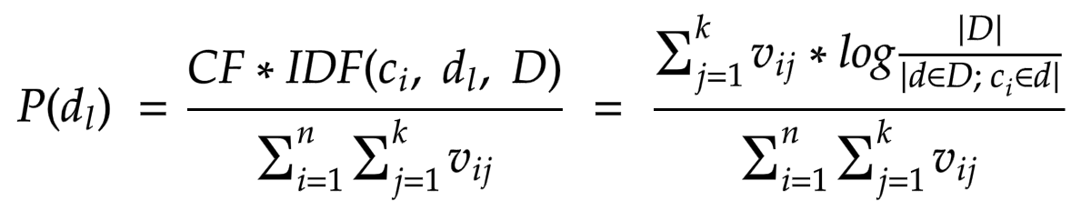
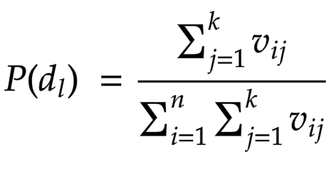

Experiments
All word embeddings
[0.27 0.41 ... -0.14]
[0.31 0.09 ... -0.04]
All sentence embeddings
[0.10 0.28 ... 0.21]
[-0.10 0.04 … -0.09]
GMM
GMM
‘organic’
𝑣 = [-0.22 0.31 ... 0.22]
⤶
‘enjoy shopping amazon ?’
[0.22 0.26 … 0.25] = 𝑣
⤷
￬
￬

Slide 14

Experiments
All word embeddings
[0.27 0.41 ... -0.14]
[0.31 0.09 ... -0.04]
All sentence embeddings
[0.10 0.28 ... 0.21]
[-0.10 0.04 … -0.09]
GMM
GMM
‘organic’
𝑣 = [-0.22 0.31 ... 0.22]
⤶
‘enjoy shopping amazon ?’
[0.22 0.26 … 0.25] = 𝑣
⤷
￬
￬

Slide 15
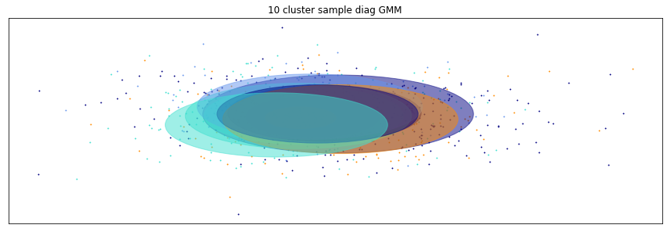
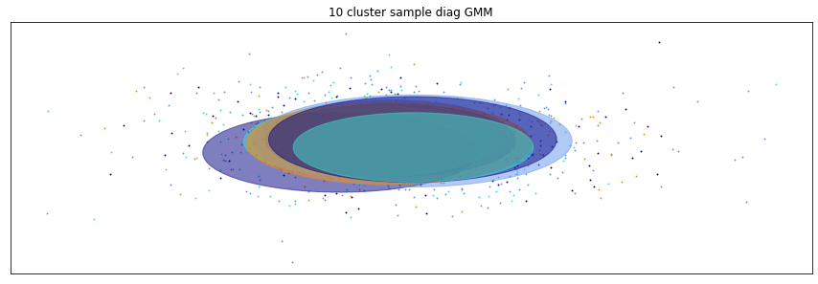
Experiments
All word embeddings
[0.27 0.41 ... -0.14]
[0.31 0.09 ... -0.04]
All sentence embeddings
[0.10 0.28 ... 0.21]
[-0.10 0.04 … -0.09]
GMM
GMM
‘organic’
𝑣 = [-0.22 0.31 ... 0.22]
⤶
‘how make sense ?’
[0.22 0.26 … 0.25] = 𝑣
⤷

Slide 16
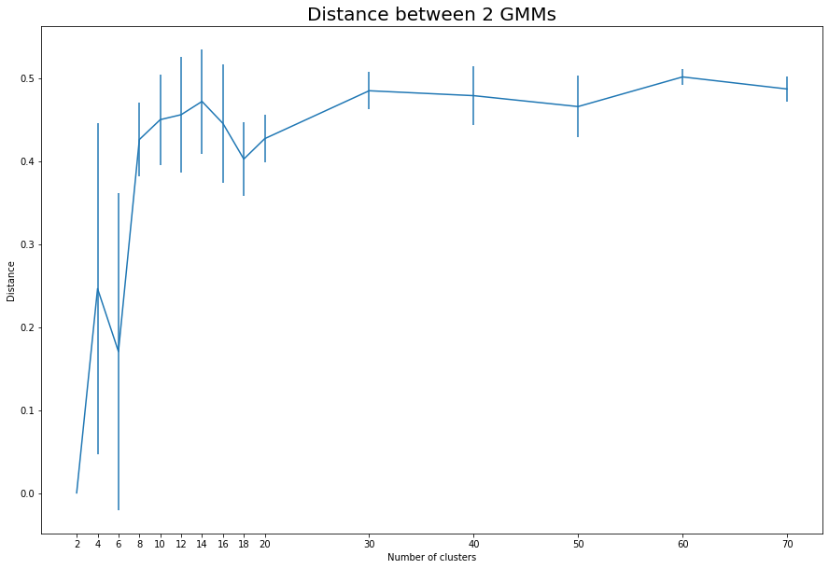
Experiments
Optimal number of clusters for word embeddings:

Slide 17
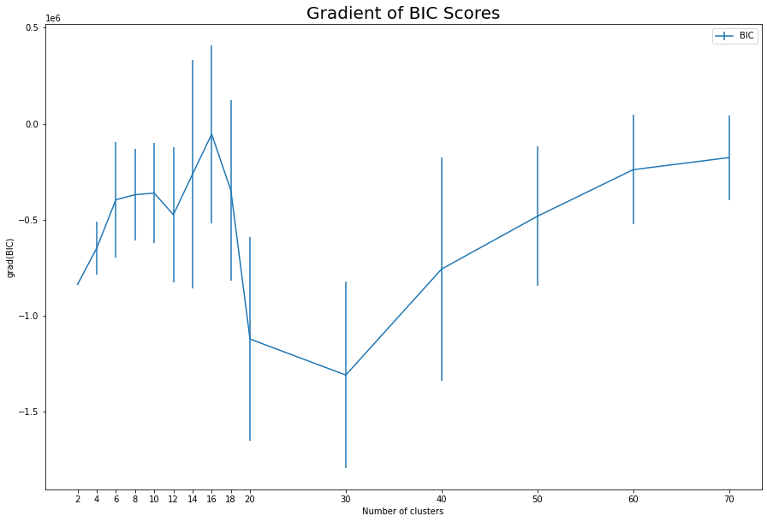
Experiments
Optimal number of clusters for word embeddings:

Slide 18
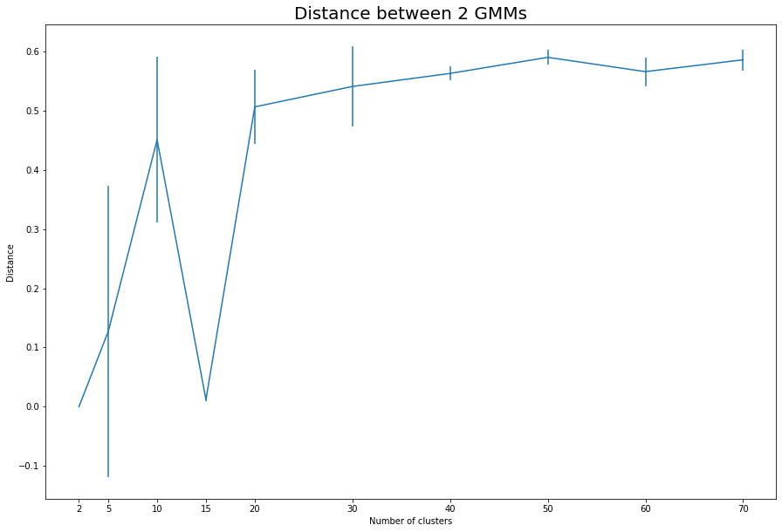
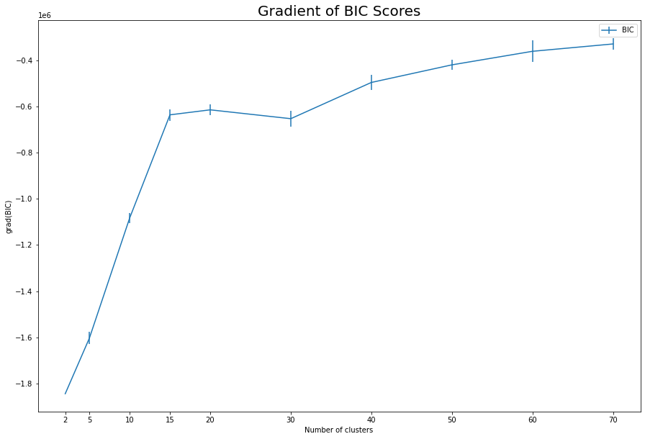
Experiments
Optimal number of clusters for sentence embeddings:

Slide 19
Experiments
How do we label Gaussians in a GMM model?
Find the most representative words
Manually select a topic
Embeddings
Gaussian

Slide 20
Experiments
Calculate Clarity Score for each word
Sentence Embeddings
Normalized Embeddings
Word Embeddings
Cosine Distance
Gaussian Mean
Notes:
How much a word in a sentence effects that sentence to be the respective gaussian.

Slide 21
Outline
Motivation
Data
Experiments
Results

Slide 22
Results
How the users are distributed?
in Word embedding space
in Sentence embedding space

Slide 23
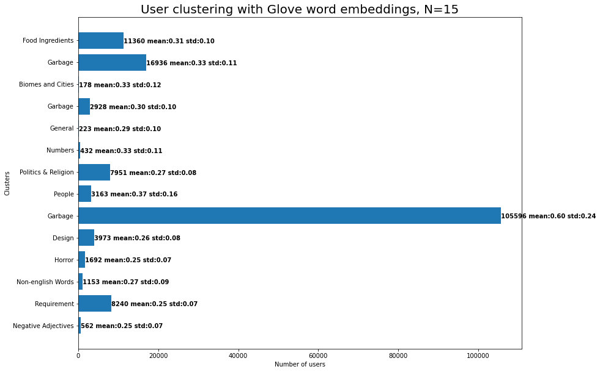
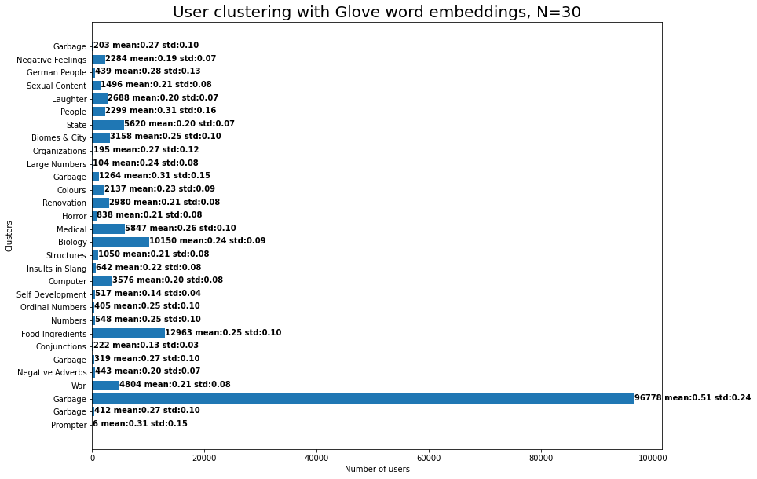
Results

Slide 24
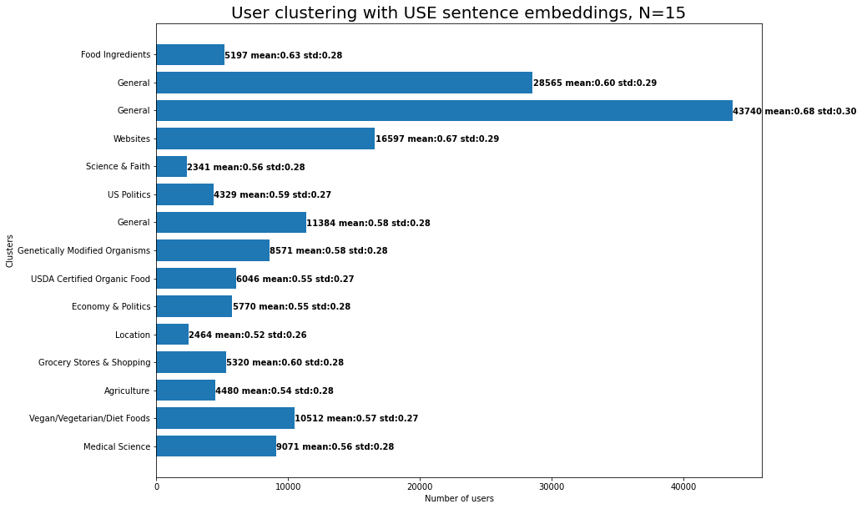
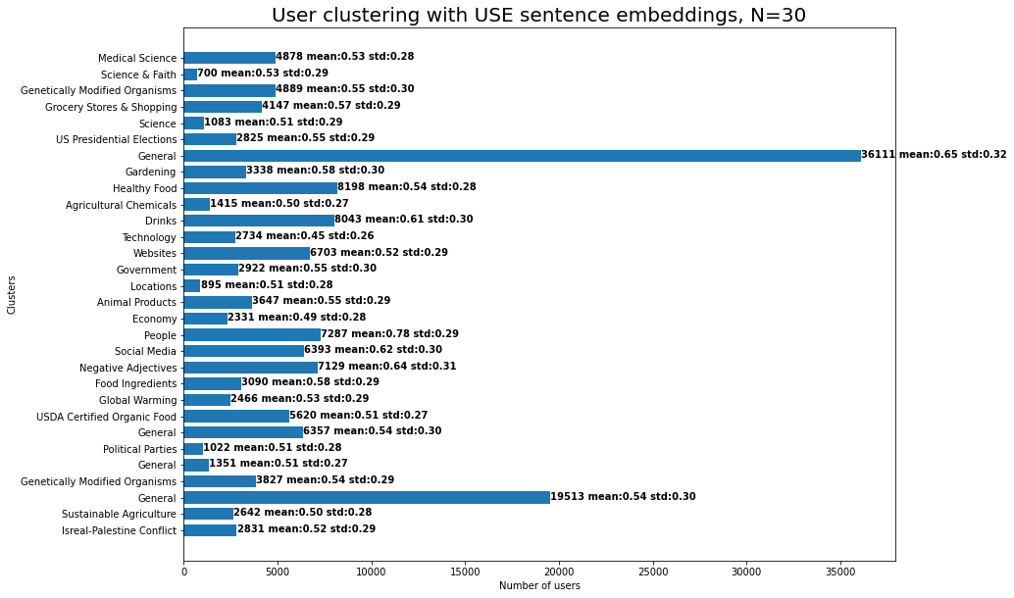
Results

Slide 25
Results
Hypothesis: Answering users should be closer to the article than random users.
Article Probability Distribution
User Probability Distribution
Janson-Shannon Divergence

Slide 26
Results
Article X Probability Distribution
User 1 Probability Distribution
Article X Probability Distribution
User 2 Probability Distribution
Janson-Shannon Divergence
Janson-Shannon Divergence
For one Article
D₁
D₂
D₃
D₄
D_{N}
Mean over Users
Standard Deviation over Users

Slide 27
Results
M₁
M₂
M₃
M₄
M_{K}
Average Mean over Articles
S₁
S₂
S₃
S₄
S_{K}
Average Standard Deviation over Articles

Slide 28
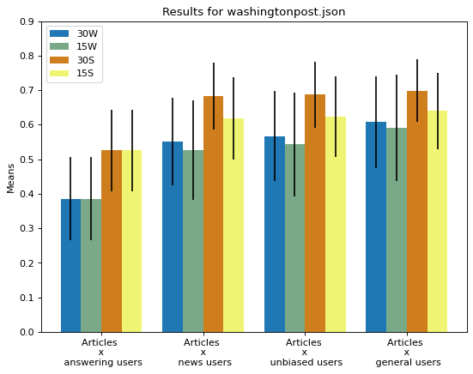
Results

Slide 29
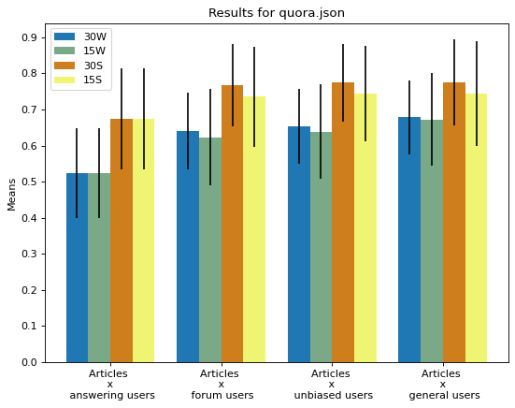
Results

Slide 30
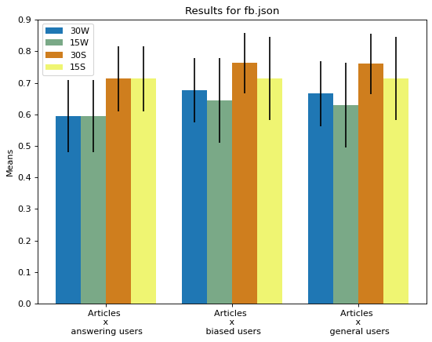
Results

Slide 31

Results
Agriculture
Amazon to buy Whole Foods Market in deal valued at $13.7 billion
Amazon.com jolted the grocery industry Friday when it announced plans to buy Whole Foods Market, introducing new uncertainty to a sector already struggling to keep up with growing competition. The $13.7 billion deal heightens a years-long battle between Amazon, the Internet darling, and powerhouse merchants such as Walmart, which recently beefed up its online operations with a $3.3
billion purchase of an Amazon competitor. Now Seattle-based Amazon - which for years has been testing grocery innovations in quiet corners - could lay claim to a fleet of more than 460 stores throughout the United States, Canada and Britain…..
Comments:
Guy above shows that this is not the scenario I thought it was. Still annoying though - Yeah, I definitely missed that development. I wonder if that will eventually be deemed illegal...
I enjoy shopping with Amazon. I am a Prime member and their shipping and customer service is However, I am considering not renewing next year as I have split some of my shopping over to Jet.com (Which Walmart acquired last year)....
There are I mean literally very few. But the dishes are priced. is one of the leading Organic caterers in Bangalore. With over a 100 organic dishes,....
Economy
D₂
You can find many online grocery stores like Dalbasket which is well-established and renowned for providing the different types of pulses...
Politics
D₁
Organic Food
D₁ < D₂

Slide 32
Results

Slide 33
Thanks for listening!
Questions ❓

Slide 34
References
Pennington, Jeffrey, Richard Socher, and Christopher D. Manning. "Glove: Global vectors for word representation." Proceedings of the 2014 conference on empirical methods in natural language processing (EMNLP). 2014.
Sridhar, Vivek Kumar Rangarajan. "Unsupervised topic modeling for short texts using distributed representations of words." Proceedings of the 1st workshop on vector space modeling for natural language processing. 2015.
Fine tune GloVe embeddings using Mittens
A fast implementation of GloVe, with optional retrofitting
Basics of using pre-trained glove vectors in python
Sklearn Gaussian Mixture Model
Gaussian Mixture Model Clusterization how to select the number of components clusters
Kl divergence of two gmms
How to find the similarity between two probability distributions using python
Cer, D., Yang, Y., Kong, S. Y., Hua, N., Limtiaco, N., John, R. S., ... & Sung, Y. H. (2018). Universal sentence encoder. arXiv preprint arXiv:1803.11175.
Angelidis, Stefanos, and Mirella Lapata. "Summarizing opinions: Aspect extraction meets sentiment prediction and they are both weakly supervised." arXiv preprint arXiv:1808.08858 (2018).
Kim, Han Kyul, Hyunjoong Kim, and Sungzoon Cho. "Bag-of-concepts: Comprehending document representation through clustering words in distributed representation." Neurocomputing 266 (2017): 336-352.

Slide 35
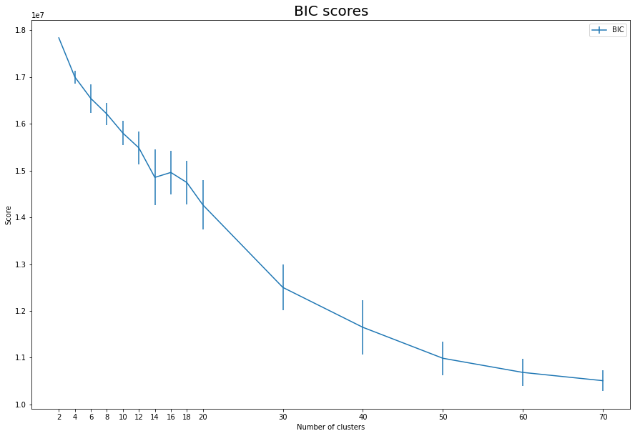
Experiments
Optimal number of clusters for word embeddings:

Slide 36
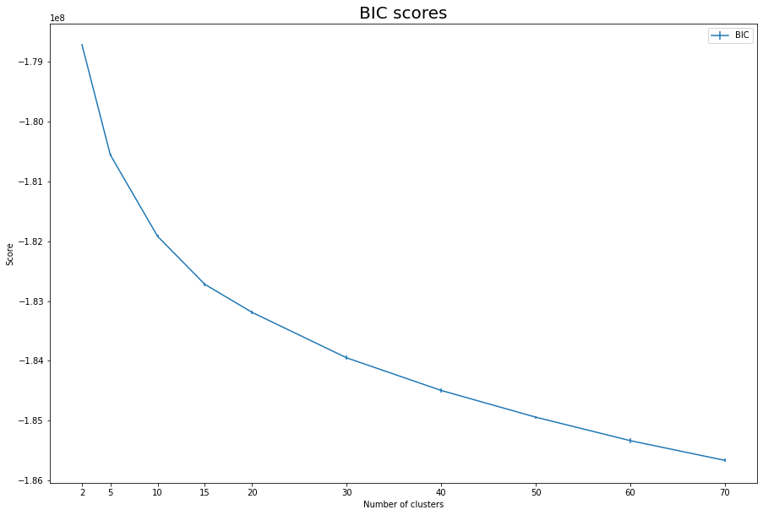
Experiments
Optimal number of clusters for sentence embeddings:

Slide 37
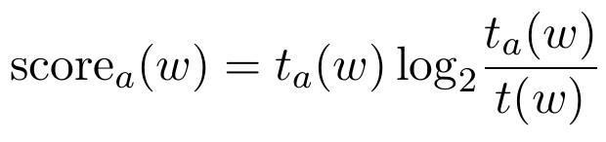
Clarity Score
Definition: Clarity score measures how much more likely it is to observe word w in the subset of segments(sentences in our case) that discuss aspect(cluster, gaussian) a, compared to the corpus as a whole.
t_{a}(w): l1-normalized tf-idf score of w in the segments annotated with aspect a.
t(w): l1-normalized tf-idf score of w in all of the segments.

Slide 38
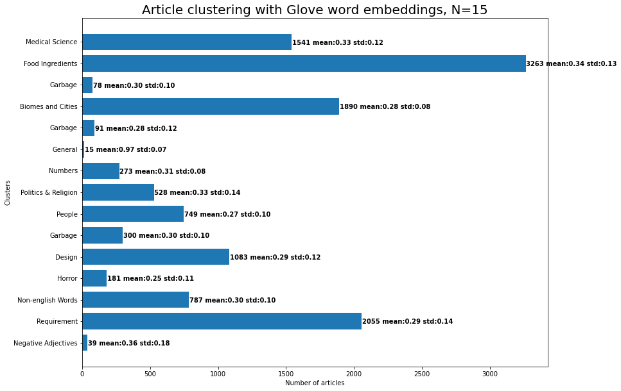
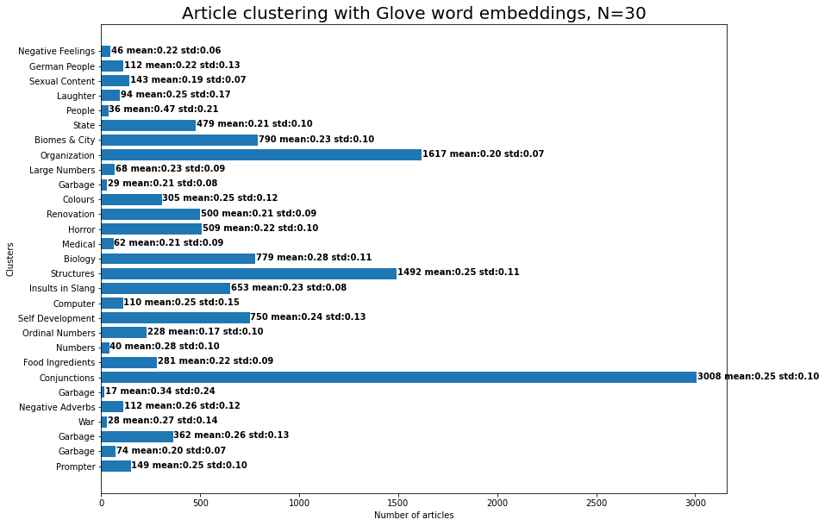
Article Clustering

Slide 39
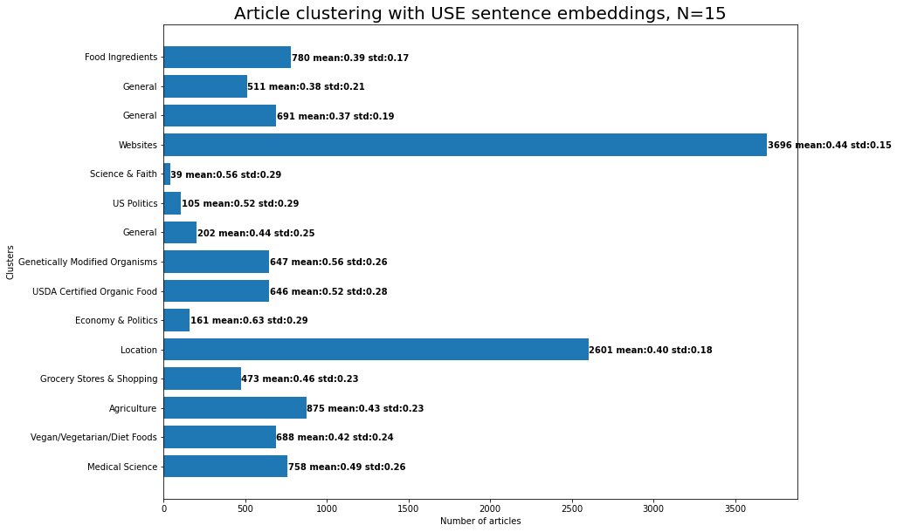
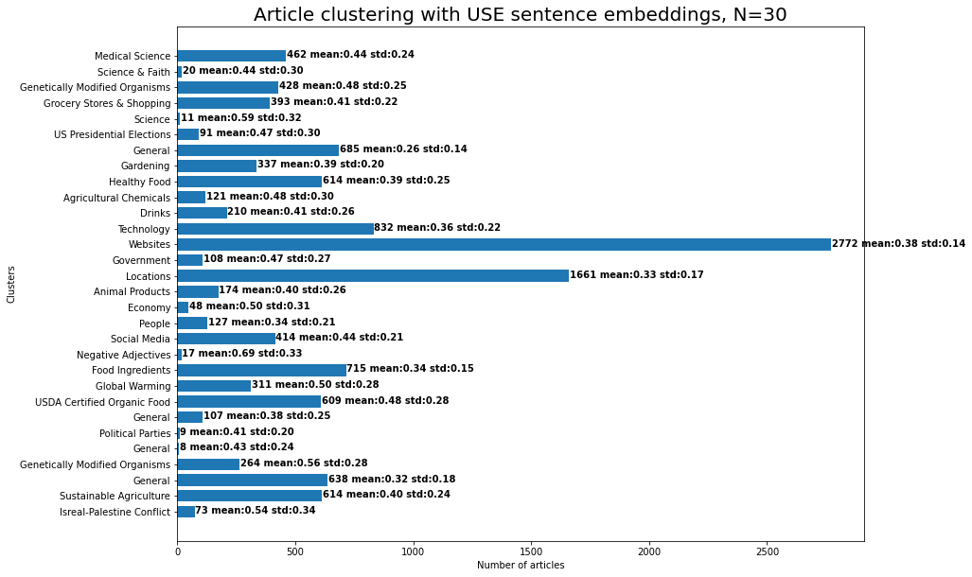
Article Clustering

